Slide 1
Statistical Modeling Explained in Python
Introduction to Correlation & Regression
Correlation & Covariance
Testing for Correlation
Linear Regression
Coefficients
Shahzaib Hamid
AI Sciences Instructor

Slide 2
Module Overview
Covariance & Correlation
Regression
Correlation
Covariance
Example
Correlation
Example
Analysis
Linear
Visual
Coefficient
Testing for Correlation

Slide 3

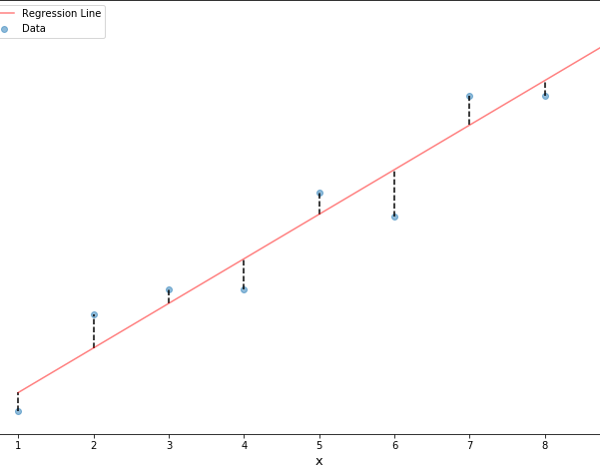
Regression Analysis – Covariance and Correlation
Do two random variables move together?
Summary Statistics
Covariance & Correlation

Slide 4
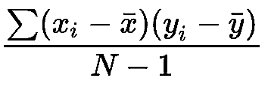

Covariance
Formula
The covariance between two random variables measures the degree to which the two variables move together – it captures the linear relationship.
Sample variance:
_{σ}𝑛
𝑠² =
𝑖=1
(𝑋_{𝑖} − 𝑋⁾ (𝑋_{𝑖} − 𝑋⁾
𝑛 − 1
sample size
ith observation on variable X
mean of the variable X
ith observation on variable Y
mean of the variable Y
𝑐𝑜𝑣_{𝑋𝑌} =
𝑛 − 1
Properties
Positive covariance: variables move together
Negative covariance: variables move in opposite directions
Covariance of variable with itself == variance

Slide 5
Covariance – Example and Pitfalls
(Pitfalls)
Actual value of covariance not meaningful
Can range from minus to plus infinity
Squared units
mean
5.00
10.11
X | 1 | 2 | 3 | 4 | 5 | 6 | 7 | 8 | 9
y | 2 | 6 | 7 | 7 | 11 | 10 | 15 | 15 | 18
1−5.00 2−10.11 + 2−5.00 6−10.11 + …+(9−5.00)(18−10.11) _{= 13.75}
𝑐𝑜𝑣 =
𝑋𝑌
9−1

Slide 6
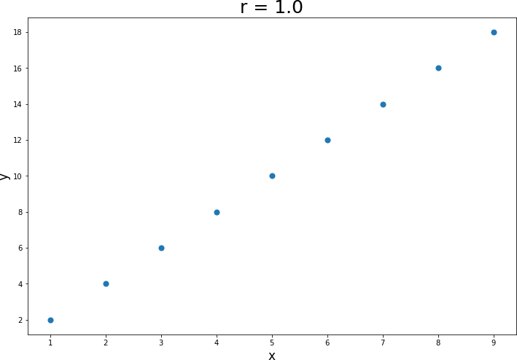
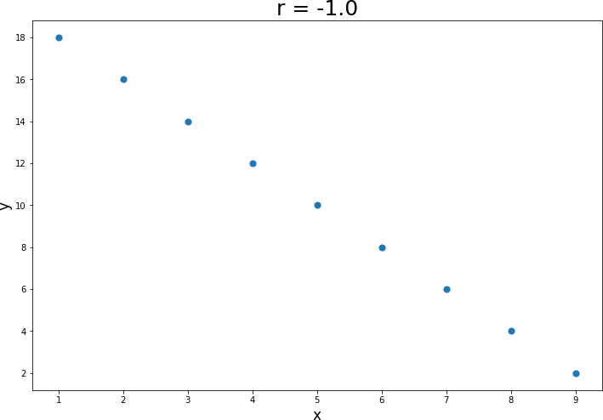
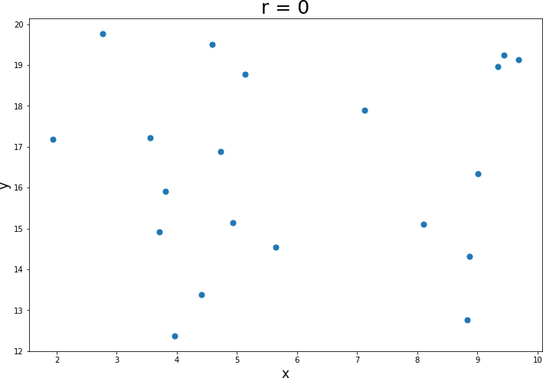
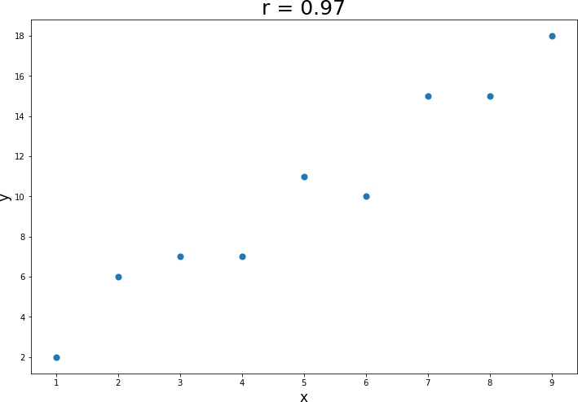
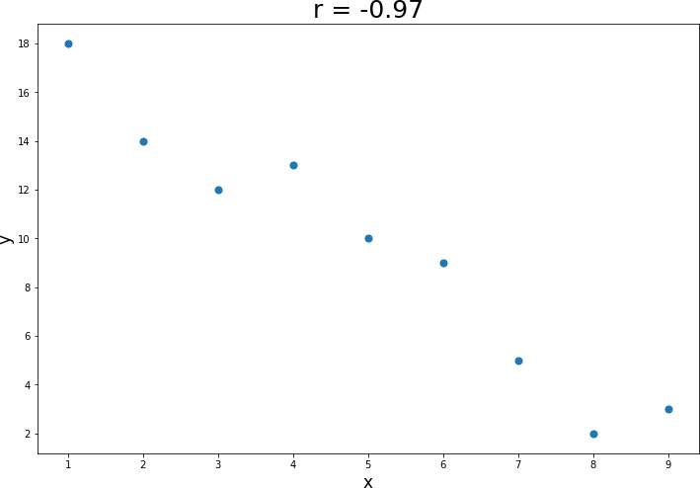
Testing for Correlation
Statistical Test of
Significance (r = 0)
Statistical Test of
Significance (r = 0)

Slide 7
Regression Analysis
Simple Linear Regression

Slide 8
Linear Regression
The purpose of simple linear Regression is to explain (the variation in) a dependent variable by (the variation in) a single independent variable.
dependent / explained / predicted Variable: Movie Revenue (Y)
independent / explanatory / predicting Variable: Movie Budget (X)
→ Setting up a linear equation (straight line):
𝑋_{𝑖}: ith observation of the dependent variable X
𝑌_{𝑖} : ith observation of the independent variable Y
𝑎: regression intercept term
𝑏: regression slope coefficient
𝜀_{𝑖}: residual for the ith observation (error term)
𝑌_{𝑖} = 𝑎 + 𝑏𝑋_{𝑖} + 𝜀_{𝑖}
Revenue Budget

Slide 9
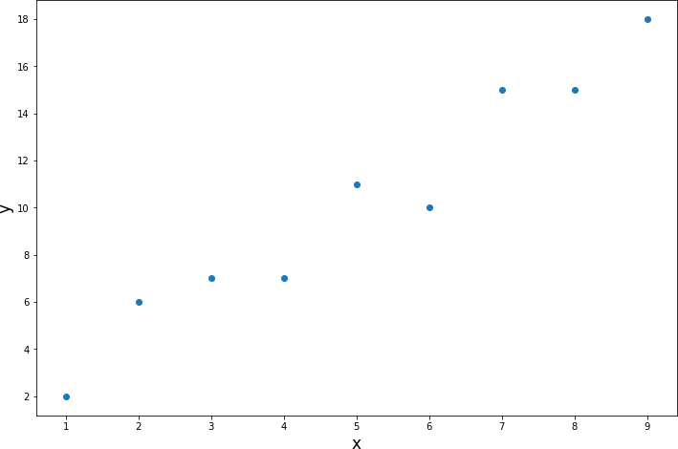
Linear Regression – Visual Interpretation
The purpose of simple linear Regression is to explain (the variation in) a dependent variable by (the variation in) a single independent variable.
dependent / explained / predicted Variable: Movie Revenue (Y)
independent / explanatory / predicting Variable: Movie Budget (X)
→ Setting up a linear equation (straight line):
𝑋_{𝑖}: ith observation of the dependent variable X
𝑌_{𝑖} : ith observation of the independent variable Y
𝑎: regression intercept term
𝑏: regression slope coefficient
𝜀_{𝑖}: residual for the ith observation (error term)
𝑌_{𝑖} = 𝑎 + 𝑏𝑋_{𝑖} + 𝜀_{𝑖}
Revenue Budget

Slide 10
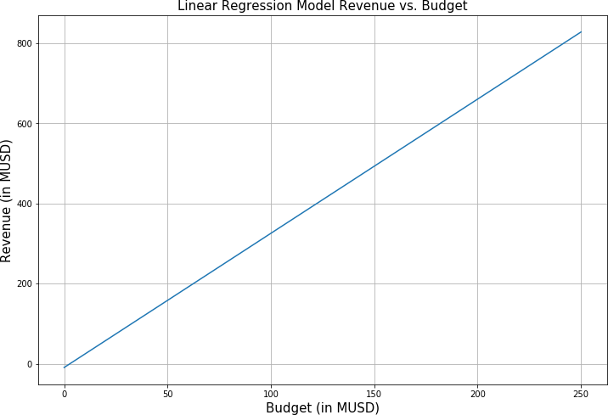
Linear Regression – Intercept and Slope Coefficient
Simple way to calculate slope coefficient b:
𝒄𝒐𝒗_{𝑿𝒀}
3.35 MUSD Revenue increase
per 1 MUSD Budget increase
^{𝒃 =} 𝑽𝒂𝒓 𝑿
𝑌_{𝑖} = 𝑎 + 𝑏𝑋_{𝑖} + 𝜀_{𝑖}
Revenue Budget
∆𝑌 ∆𝑅𝑒𝑣𝑒𝑛𝑢𝑒
slope b =
=
= 3.35
∆𝑋 ∆𝐵𝑢𝑑𝑔𝑒𝑡
Intercept a = -9.45 MUSD
Revenue if Budget == 0

